Slide 1
Project Idea Presentation
Presenting by Group-3
Mithi Shams ID: 1211041042
Ariful Hasan Kawshiq ID: 1510313042
Shafika Islam ID: 1610239042
Junior Design Course
Instructor : Shaikh Shawon Arefin Shimon (SAS3)

Slide 2
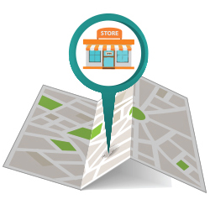
Shop Finder For A better shopping experience
An Android Application

Slide 3
INTRODUCTION: PUPOSE/GOAL:

Slide 4
SCOPE:

Slide 5

TOOLS:

Slide 6
Features:
Register or Log In Button (both Admin and User interface)
Create List Button
List of items and shops
Home screen
Shop details (database)
Map view

Slide 7
Release Plan: Our system can search for any item that is listed by the user. It provides the user with the name of the shops and on clicking on any of the shop, user is directly directed to the map. From this user gets a clear direction of the chosen shop. Also our 3 main release plans are -
Android Interface implementation.
Create database management system to insert data and retrieve data.
Merge Android Application and Database system.

Slide 8
Future works: We have some more plans with our system. In future we plan to integrate customer feedback system. We also plan to integrate customer behavior prediction pattern in our system.

Slide 9
Thank you!

